Slide 1
CHM 5681
Transient Absorption
Source
Source
hν
Detector
hν
Sample

Slide 2
Molecular Photophysics
phosphorescence
fluorescence
internal
conversion
intramolecular charge transfer
hν
conformational change
Molecule
electron transfer
photochemical transformation
proton transfer
exiplex formation
energy transfer
excimer formation

Slide 3
Events in Time
Photochemistry
Isomerization
Excitation
Intersystem Crossing
Fluorescence
Phosphorescence
Internal Conversion
1 fs
1 ps
1 ns
1 μs
1 ms
1 s
femto
pico
nano
micro
milli
seconds
0.000 000 001 s
0.000001 s
0.001 s
1 s
0.000 000 000 001 s
0.000 000 000 000 001 s

Slide 4
Molecular Photophysics
Steady-state Emission
Time-resolved Emission
phosphorescence
fluorescence
internal
conversion
intramolecular charge transfer
hν
Absorption Spectroscopy
conformational change
Molecule
electron transfer
photochemical transformation
proton transfer
NMR
Mass-spec
X-ray…
exiplex formation
energy transfer
excimer formation
Non-radiative Decay

Slide 5
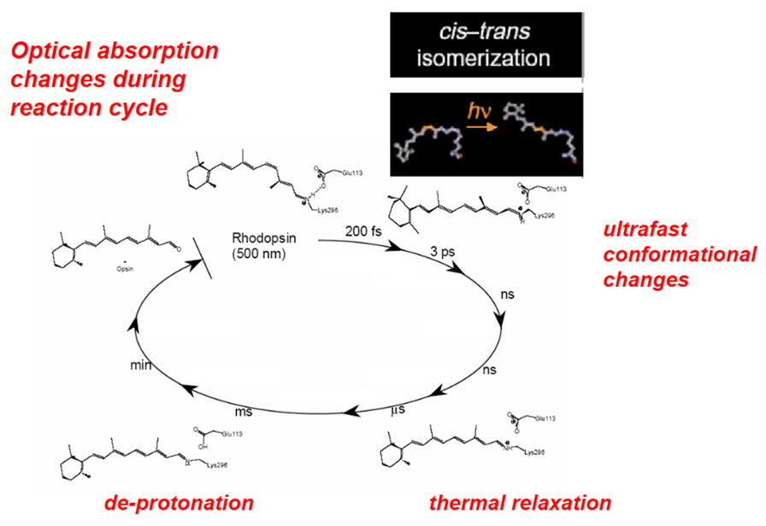
Transient Absorption Spectroscopy

Slide 6
Spectroscopy
Absorption
Fluorometry
Source
Source
Detector
hν
Detector
hν
emission
Sample
Sample
Source
Transient Absorption
1) High intensity pulse of light.
2) Monitor color change over time.
Source
hν
Detector
hν
Sample

Slide 7
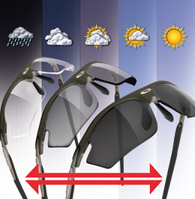
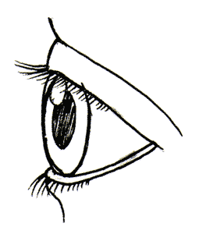
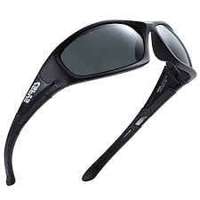
Transient Absorption Spectroscopy
Excitation Source
hν
hν
Source
Sample
Detector
Excitation Source
TA of Photochromic Sunglasses
1) Excitation (sunlight)
2) Go inside
3) Monitor color change over time
(seconds to minutes)
Source
hν
Detector
hν
Sample

Slide 8
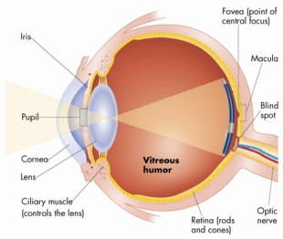
Visual Spectroscopy
“The human eye and its brain interface, the human visual system, can process 10 to 12 separate images per second (10 Hz), perceiving them individually.”
100 ms or 0.1 s
10 ms or 0.01 s
Time
Time
Perceived as green and then red.
Perceived as yellow.

Slide 9
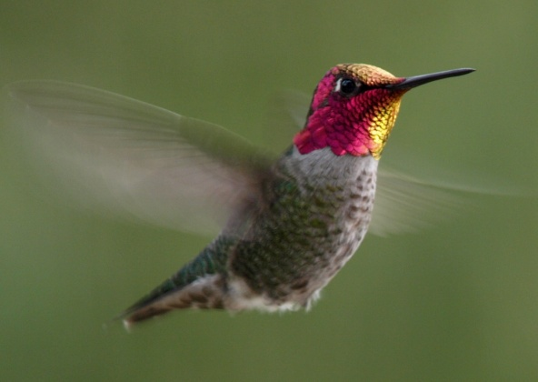
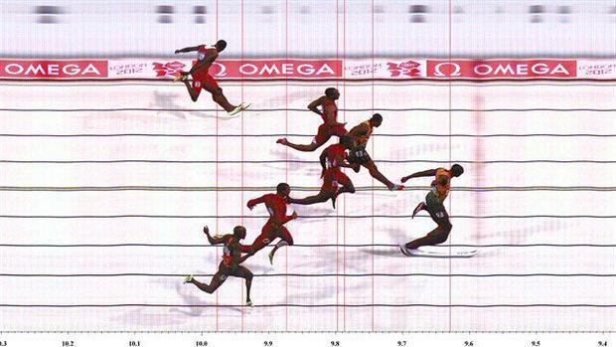
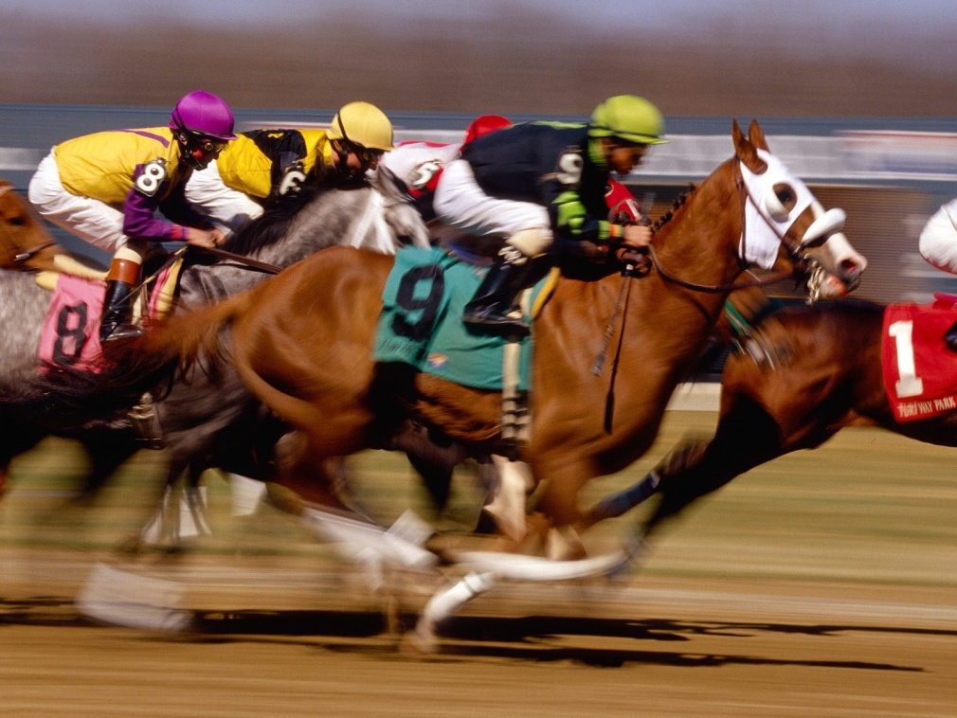
We are missing out!
70 Hz
14 ms
1000 Hz
1 ms

Slide 10
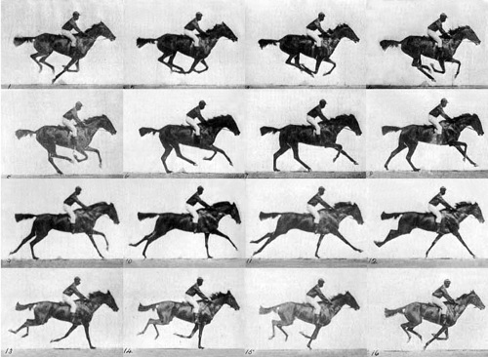
Time-resolved Spectroscopy
Eadweard Muybridge
The Horse in Motion (1872)
Notes:
photography pioneer Eadweard Muybridge, on commission from Leland Stanford, took several years to develop a system of rapid-sequence photography to conclusively

Slide 11
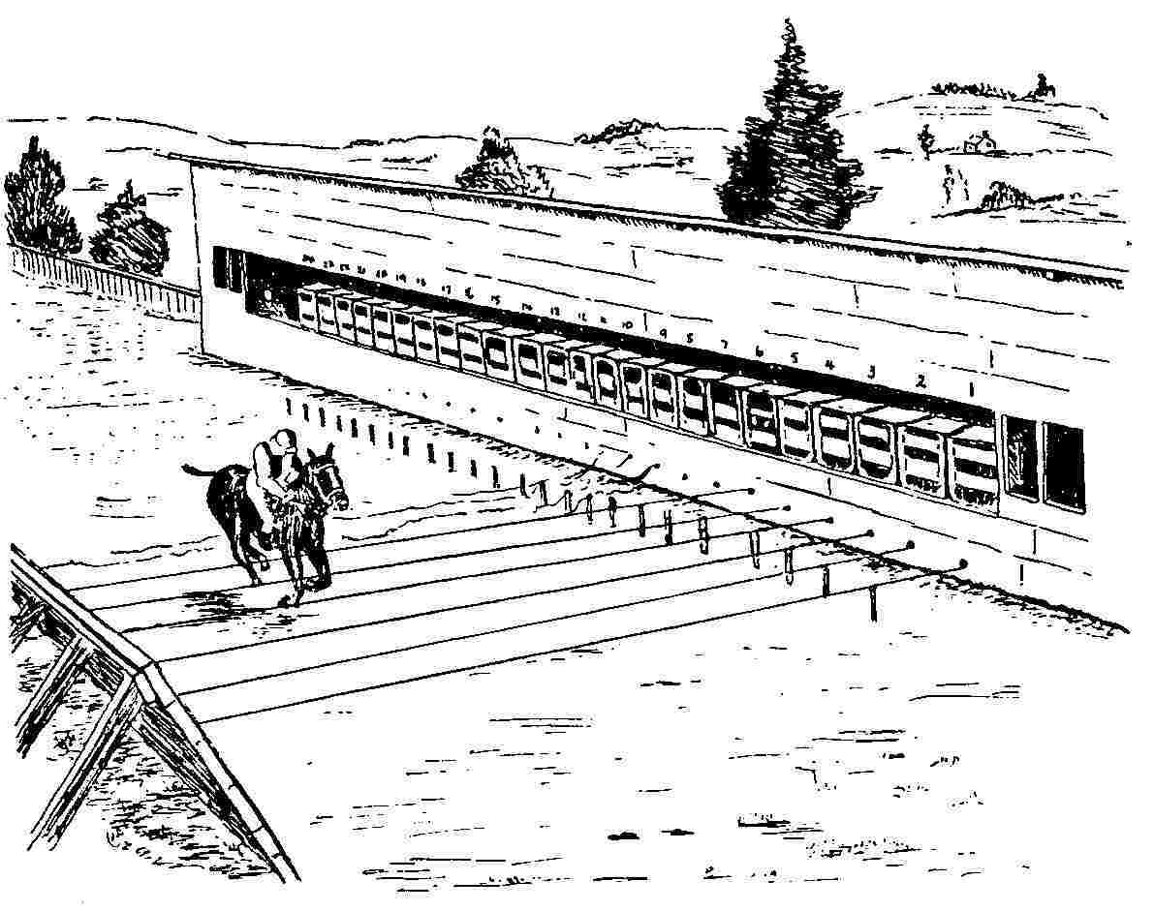
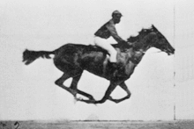
Time-resolved Spectroscopy
Muybridge was able to record events on the scale of about 0.001 second in 1877
1 ms time resolution!

Slide 12
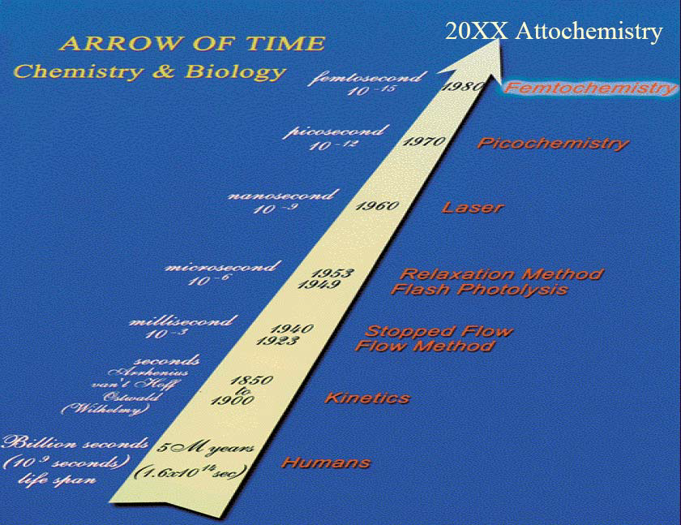
Spectroscopy Timeline
150 years = 17 orders of magnitude
17 orders of magnitude (bacteria vs. size of the solar system)

Slide 13
Time-Resolved Timeline

Slide 14
Transient Absorption Spectroscopy
Source
Source
hν
Detector
hν
Sample
Transient Absorption (Pump-Probe Experiment)
1) High intensity pulse of light.
2) Monitor absorption spectrum over time.

Slide 15
Transient Absorption Spectroscopy
Electron Transfer Dynamics
hν
A
C
A
C*
A⁻
C⁺

Slide 16
Transient Absorption Spectroscopy
Electron Transfer Dynamics
A
C
A
C*
A⁻
C⁺

Slide 17
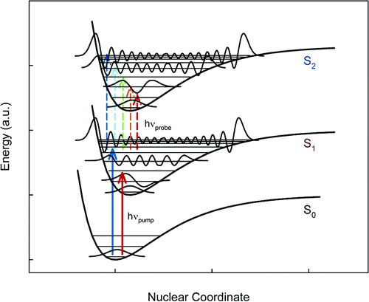
Transient Absorption Spectroscopy
C
C*
Excited State Absorption Spectra
1) Excitation (hν_{pump})
2) Absorption Spectra (hν_{probe})
Notes:
Pump Photons create the excited state in a given vibrational state. Probe photons are absorbed by the excited state. The difference in intensity between the incident and transmitted probe photons gives the measured signal. The transmitted intensity changes as the excited state population in the S₁ state decays. Possible decay processes.
Changing Pump Wavelength places the S₁ state in a different vibrational level. Higher in the vibrational manifold, there is a higher density of states due to anharmonicity. Increases the Franck-Condon overlap and facilitates vibrational decay.
Probe Wavelength: Higher vibrational states have a wider range of absorptions available due to greater franck-condon overlap with a larger number of vibrational states in the upper level. There are many more nodes in the highly excited vibrational wavefunction and more amplitude over the nuclear coordinate.
Reference: Cr(acac) paper.

Slide 18
Absorption by the Numbers
hν
hν
Sample
We don’t measure absorbance. We measure transmittance.
Sample
Transmittance:
T = P/P₀
P₀
P
Absorbance:
A = -log T = log P₀/P
(power in)
(power out)

Slide 19
Basics of TA Measurement
Source
(2)
Events:
1) Absorption Spectra
2) Excitation Flash
3) Absorption spectra
Source
hν
Detector
hν
(1)
(3)
Sample
(1)
(3)
Excited Processes
Ground State
pump
probe
probe
probe
Time

Slide 20
Difference Spectra
S₁
4 excited states/100 molecules
E
hν
S₀
A for xS₀ molecules
A for (x - y)S₀ + yS₁ molecules

Slide 21
Difference Spectra
A(t) - A(0) = ΔA
A(0) = absorption without laser pulse
A(t) = absorption at time t after laser pulse
A(t)
A(0)
ΔA at time t
-
=
A for
(x - y)S₀ + yS₁
A for
xS₀
- yS₀ + yS₁

Slide 22
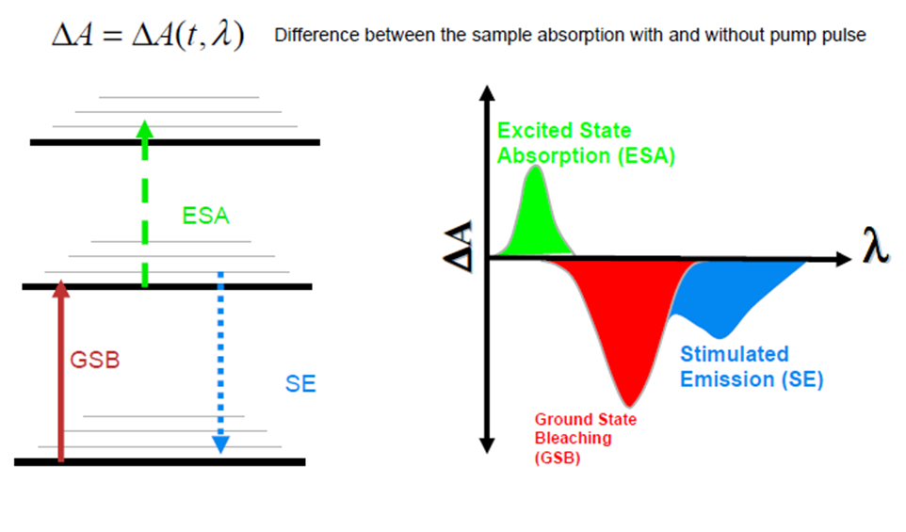
Difference Spectra
∝ S₁ generated
∝ S₀ lost
We don’t get to measure absorbance!

Slide 23
Difference Spectra
We don’t’ measure absorbance, we measure transmittance!
Sample
Absorbance:
A = -log T = log P₀/P
P₀
P
(power in)
(power out)
A(t) - A(0) = ΔA
P₀(t)
P₀(0)
A(t) = log
A(0) = log
P(t)
P(0)
Probe source
is the Same
P₀(t) = P₀(0)
P(0) = power out before pump
P(t) = power out after pump
P(0)
Then:
ΔA = log
P(t)

Slide 24
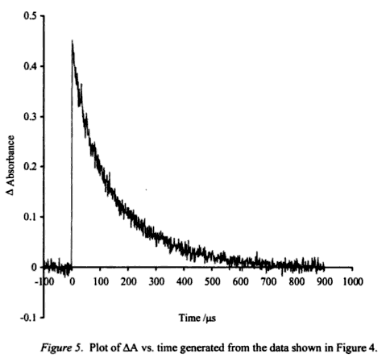
TA Measurement
Source
(2)
Events:
1) Measure P(0)
2) Pump
3) Measure P(t)
Source
hν
Detector
hν
(1)
(3)
Sample
(1)
(3)
P(0)
ΔA = log
P(t)
P(0) = power out before pump
P(t) = power out after pump

Slide 25
TA Measurement
Full spectra detection
Single λ detection
Pump
Pump
Detector
Detector
hν
hν
Probe
Probe
hν
hν
Sample
Sample

Slide 26
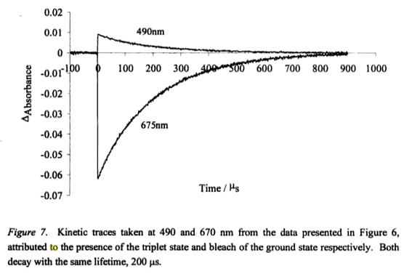
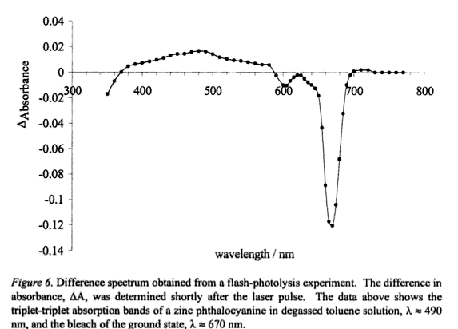
Single Wavelength to Full Spectrum
Single Wavelength
Full Spectrum Data

Slide 27
Events in Time
Photochemistry
Isomerization
Excitation
Intersystem Crossing
Fluorescence
Phosphorescence
Internal Conversion
1 fs
1 ps
1 ns
1 μs
1 ms
1 s
femto
pico
nano
micro
milli
seconds
Nanosecond TA
Femtosecond TA
Picosecond TA
Attosecond TA
Notes:
Human experience is only 9 orders of magnitude

Slide 28
Milli- to Microsecond TA (10⁻⁶ s)
Source
Source
hν
Detector
hν
Sample
First developed in the 1950s (Eigen, Norrish and Porter)

Slide 29
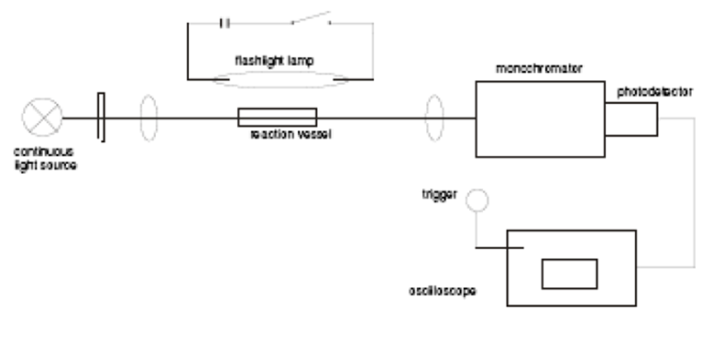
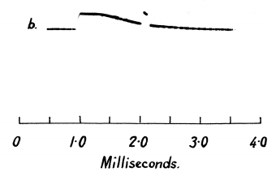
Milli- to Microsecond TA (10⁻⁶ s)
high-intensity photography lamp
1 m quartz tube
Photomultiplier tube
Tungsten lamp

Slide 30
Milli- to Microsecond TA (10⁻⁶ s)
Source
Source
hν
Detector
hν
Sample
First developed in the 1950s (Eigen, Norrish and Porter)
1967 Nobel Prize in Chemistry “for studies of extremely fast chemical reactions, effected by disturbing the equilibrium by means of very short impulses of energy”

Slide 31
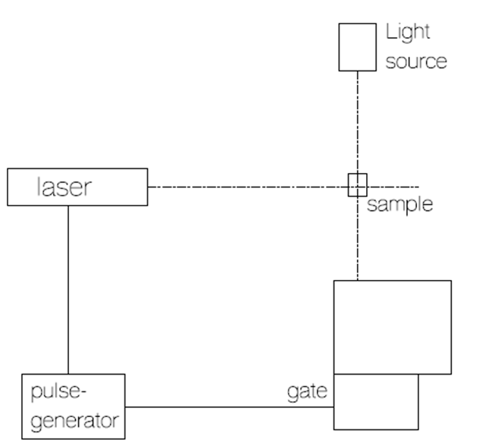
Nanosecond TA (10⁻⁹ s)
Xe Flash Lamp
Q-switch laser
Nd:YAG, Ar Ion
<10 ns pulsewidth
Mono-
chrometer
PMT

Slide 32
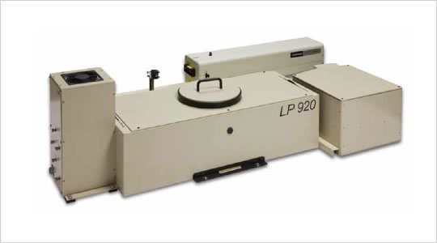
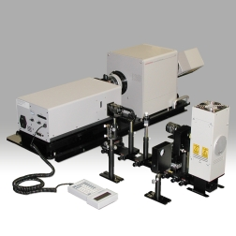
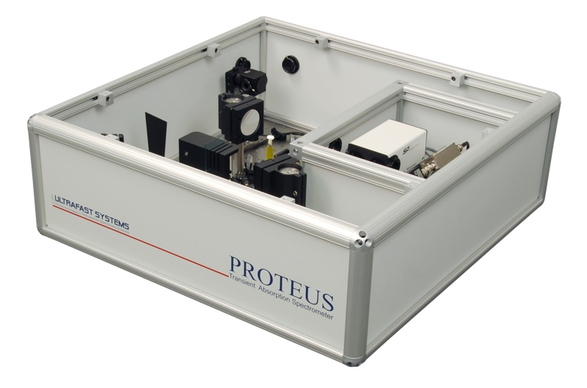
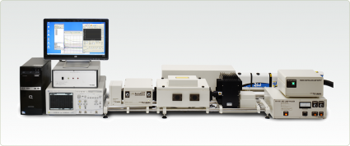
Commercial Nanosecond TA systems
Edinburgh-LP980
Hamamatsu-F157
Ultrafast Systems-Proteus
Applied Photophysics- LKS80

Slide 33
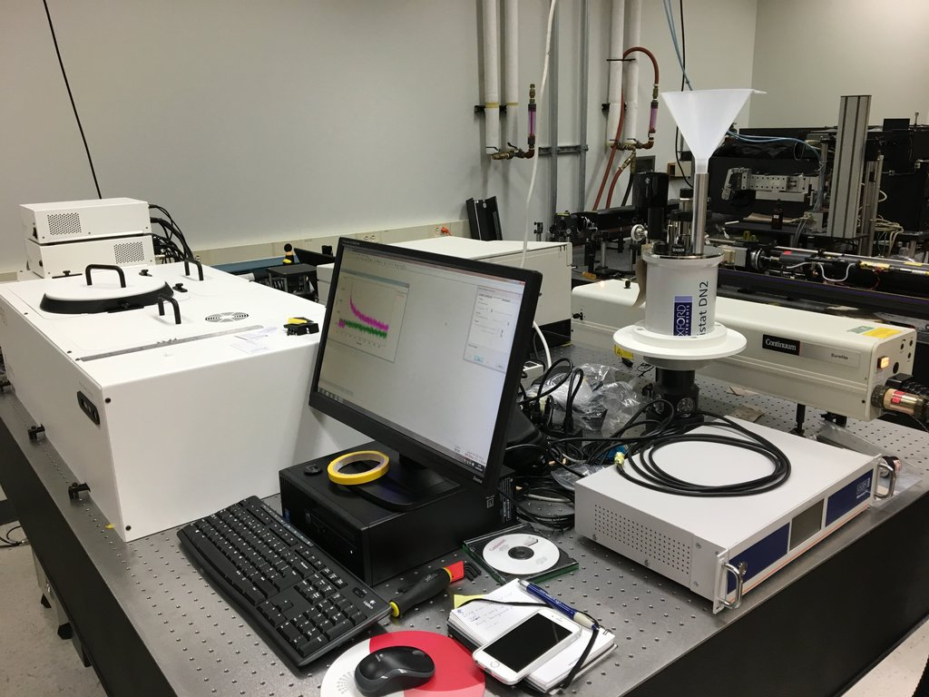
Commercial Nanosecond TA systems
Florida State University
Edinburgh-LP980
5 ns to 1 sec
λ_{ex} = 280-1500 nm
CCD
PMT
InGaS
λ_{abs} = 300-1700 nm

Slide 34
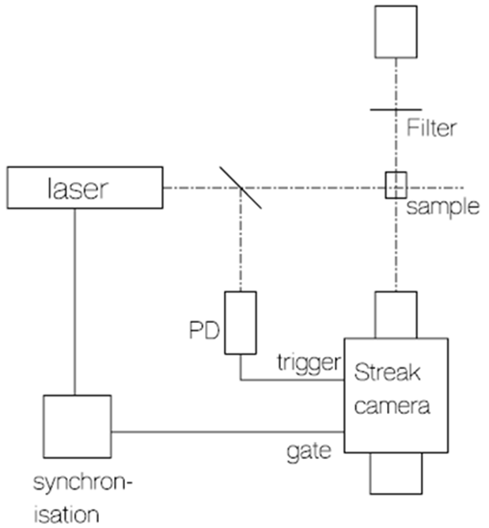
Picosecond TA (10⁻¹² s)
Flash Lamp
Or picosecond white-light continua
Mode-locked Laser

Slide 35
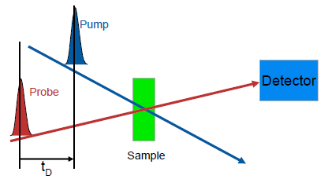
Femtosecond TA (10⁻¹⁵ s)
First developed in the 1980s (A. H. Zawail)
1999 Nobel Prize in Chemistry “for his studies of the transition states of chemical reactions using femtosecond spectroscopy"

Slide 36
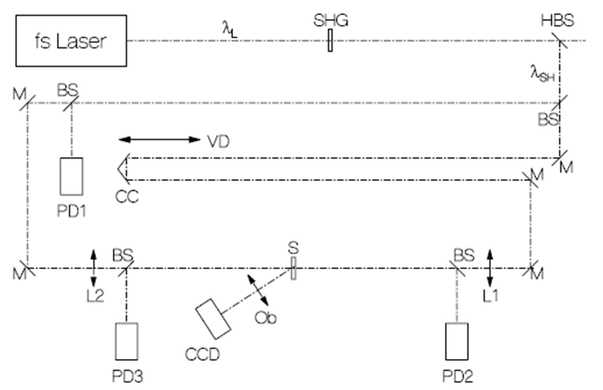
Femtosecond TA (10⁻¹⁵ s)
(1)
Pump
(2)
Probe
(3)
Delay Stage
(4)
Detector
1) Femtosecond laser pulse
2) Beam splitter (into Pump and Probe)
3) Probe Travels through Delay Stage
4) Pump hits sample (exciation)
5) Probe hits sample
6) Transmitted Probe hits detector

Slide 37
Femtosecond TA (10⁻¹⁵ s)
ΔA = log P(0)/P(t)
Pump
Graph of t vs ΔA
Transient Concentration
[Conc]
ΔA
time
time
blank P(0)
pump
probe
Transmitted Light at time 1
P(t1)
Intensity
t_{d1}
P(t)
time
time
pump
probe
Transmitted Light at time 1
P(t2)
Intensity
t_{d2}
Intensity
time
time

Slide 38
Femtosecond TA (10⁻¹⁵ s)
P(t) < P(0)
ΔA = log P(0)/P(t)
P(t) > P(0)
blank P(0)
blank P(0)
pump
pump
probe
probe
Intensity
t_{d1}
Intensity
t_{d1}
time
time
Decrease Transmitted light P(t)
Increased Transmitted
light P(t)
P(t)
P(t)
time
time
Graph of t vs ΔA
Graph of t vs ΔA
ΔA
ΔA
time
time
New species after laser pulse.
Loss of species after laser pulse.

Slide 39
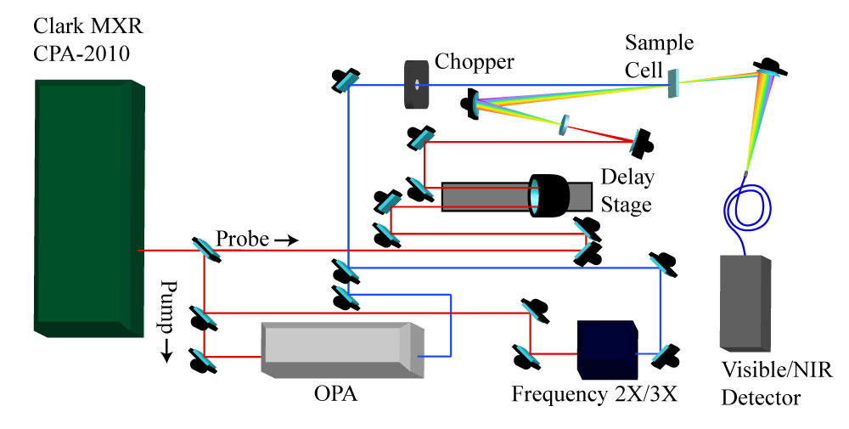
Femtosecond TA (10⁻¹⁵ s)

Slide 40
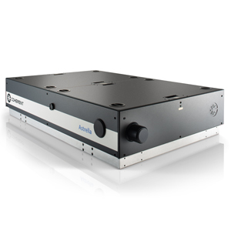
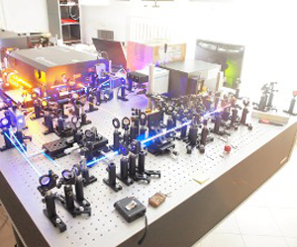
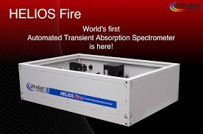
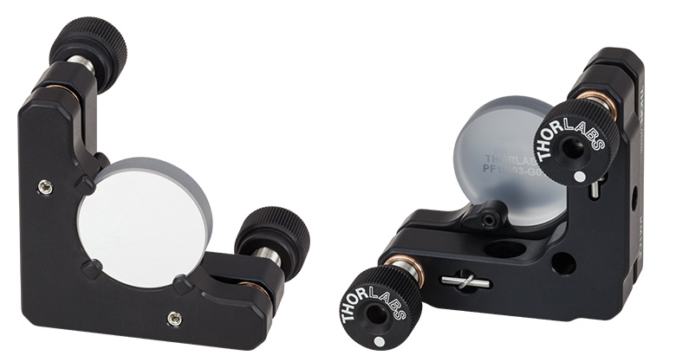
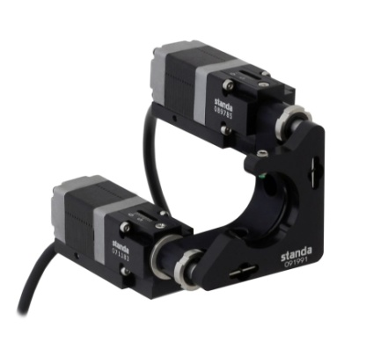
Femtosecond TA (10⁻¹⁵ s)
Home Built
Coherent Astrella
$400,000
$220,000

Slide 41
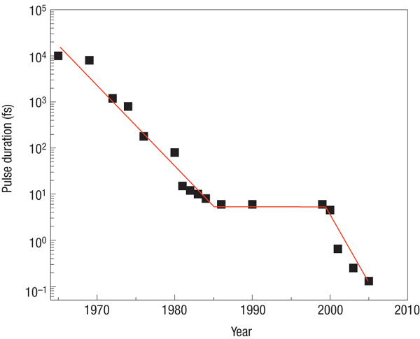
Attosecond Spectroscopy (10⁻¹⁸ s)
“However, the resolution offered by femtosecond spectroscopy is insufficient to track the dynamics of electronic motion in atoms or molecules since they evolve on an attosecond (1 as = 10−18 s) to few-fs time scale and thus remain elusive so far.”
6-fs pulse
300 attosecond pulse
67 attosecond pulse
Nature Physics 3, 381 - 387 (2007)

Slide 42
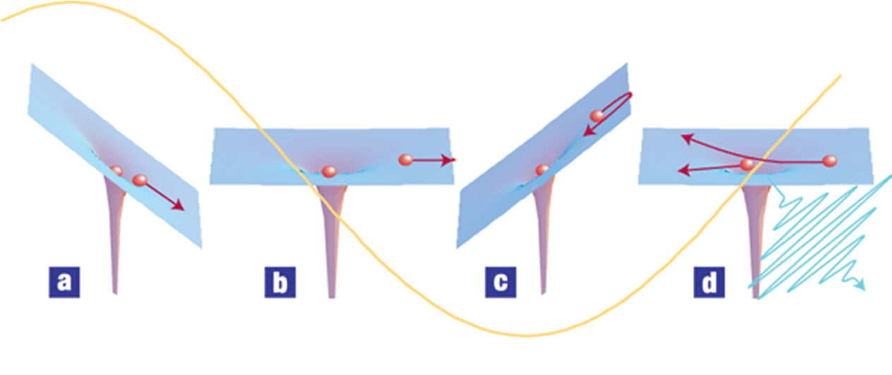
Attosecond TA
a–d, An intense femtosecond near-infrared or visible (henceforth: optical) pulse (shown in yellow) extracts an electron wavepacket from an atom or molecule. For ionization in such a strong field (a), Newton's equations of motion give a relatively good description of the response of the electron. Initially, the electron is pulled away from the atom (a, b), but after the field reverses, the electron is driven back (c) where it can 'recollide' during a small fraction of the laser oscillation cycle (d). The parent ion sees an attosecond electron pulse. This electron can be used directly, or its kinetic energy, amplitude and phase can be converted to an optical pulse on recollision.

Slide 43
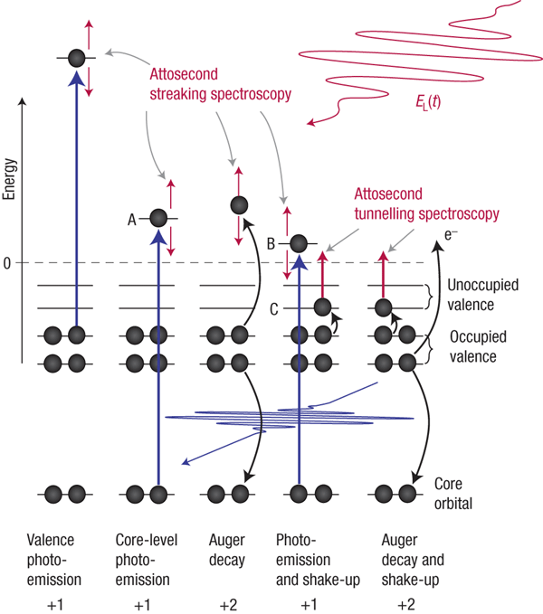
Attosecond TA
Electronic excitation and relaxation processes in atoms, molecules and solids, and possible ways of tracing these dynamics in real time.

Slide 44
Attosecond Spectroscopy (10⁻¹⁸ s)
“However, the resolution offered by femtosecond spectroscopy is insufficient to track the dynamics of electronic motion in atoms or molecules since they evolve on an attosecond (1 as = 10−18 s) to few-fs time scale and thus remain elusive so far.”
6-fs pulse
300 attosecond pulse
67 attosecond pulse
Nature Physics 3, 381 - 387 (2007)

Slide 45
Events in Time
Photochemistry
Isomerization
Excitation
Intersystem Crossing
Fluorescence
Phosphorescence
Internal Conversion
1 fs
1 ps
1 ns
1 μs
1 ms
1 s
femto
pico
nano
micro
milli
seconds
0.000 000 001 s
0.000001 s
0.001 s
1 s
0.000 000 000 001 s
0.000 000 000 000 001 s

Slide 46
Molecular Photophysics
Steady-state Emission
Time-resolved Emission
phosphorescence
fluorescence
internal
conversion
intramolecular charge transfer
hν
Absorption Spectroscopy
conformational change
Molecule
electron transfer
photochemical transformation
proton transfer
NMR
Mass-spec
x-ray…
exiplex formation
energy transfer
excimer formation
Non-radiative Decay

Slide 47
Transient Absorption End
Any Questions?

